Slide 1
Sage 300 2017.2 Web SDK Overview
John Thomas (JT)
April 06, 2017

Slide 2
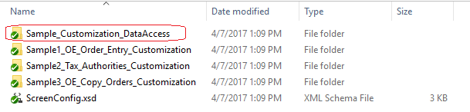
Samples
Typos and Misc. Corrections
Customization
Removed Kendo.all.min.js
New DAL sample
Updated Docs
Refactored for Global Layout Changes

Slide 3
Documentation
New Creating Clear Statistics Screen Tutorial
Updated HTML CSS Framework Guidelines
Upgrade Instructions for 2017.1 to 2017.2
New Global Layout Refactoring Guide
Updated WebApi Endpoint Reference
Updated Wizards Documents

Slide 4
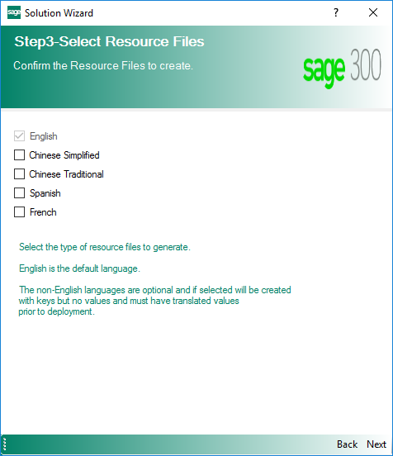
Solution Wizard
New Select Resources Step
Select the language resource(s) to be generated
Dot “.” Removed From Bundle Name
Set AutoSize to True for Buttons
Resolves sizing on different displays
Module Added to the Web Project Name
Previously ValuedPartner.Web
Now ValuedPartner.TU.Web
Global Files Updated to 2017.2

Slide 5
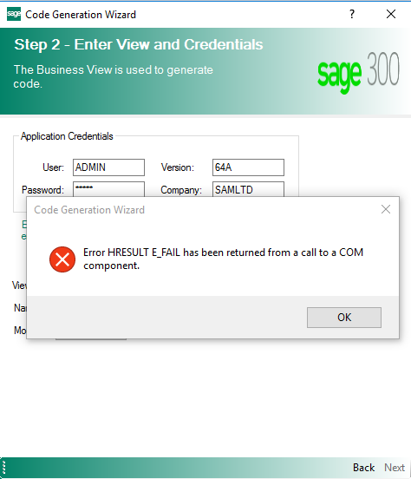
Code Generation Wizard
Display Error on Invalid View ID
Updated AccpacDotNet.props file
Accpac.Advantage now 6.4.0.20
Generates new GlobalLayout.cshtml
LocalizedLayoutR2 removed
LocalizedLayoutR3 removed
Misc. Corrections

Slide 6
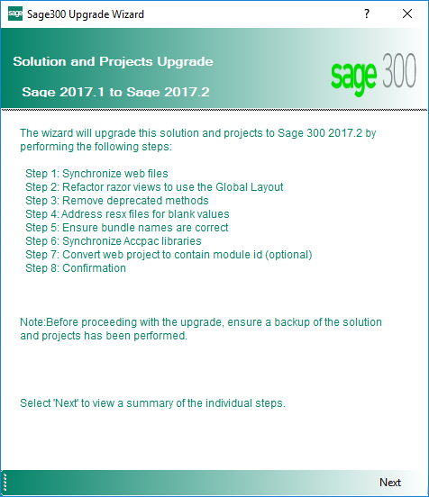
New Upgrade Wizard
Upgrades Projects and Solution
Upgrade files from 2017.1 to 2017.2
Plugin inside Visual Studio
Wizard steps you through upgrade
Log file generated upon completion
Register wizard to upgrade files
Unregister when complete
Document for manual steps in docs\upgrade

Slide 7
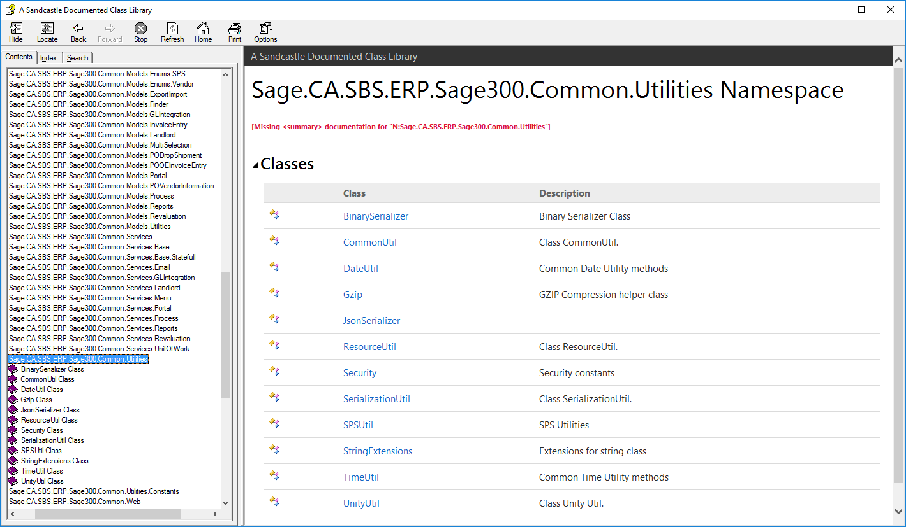
New Help File
CommonCore.chm
Help file for Common and Core assemblies
Use to see what common and core components are available
Note: …Util classes are of particular interest!
Located in help folder
Note: Still a work in progress!

Slide 8
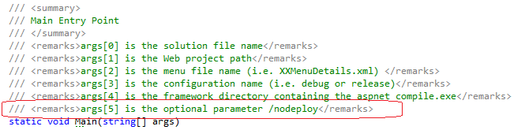
MergeISVProject
New Optional Parameter
Pre-compile, but no deploy parameter

Slide 9
GitHub Repository
Open Source
https://github.com/SageNADev/Sage300-SDK
2017.2 is available in “master” branch
2017.1 is available in the “release-2017.1” branch (archive)
2017 is available in the “release-2017” branch (archive)
2018.0 is available in the “develop” branch (in-progress)

